Slide 1
Take a Stand: Inquiry Project
District 4
READ East Harlem/Hunter College
NCTE 2018
Carly Metzger, Second Grade Teacher, PS072, NYC
Rosanne L. Kurstedt, PhD, Hunter College
Funded by New York Community Trust, Brooke Astor Fund

Slide 2
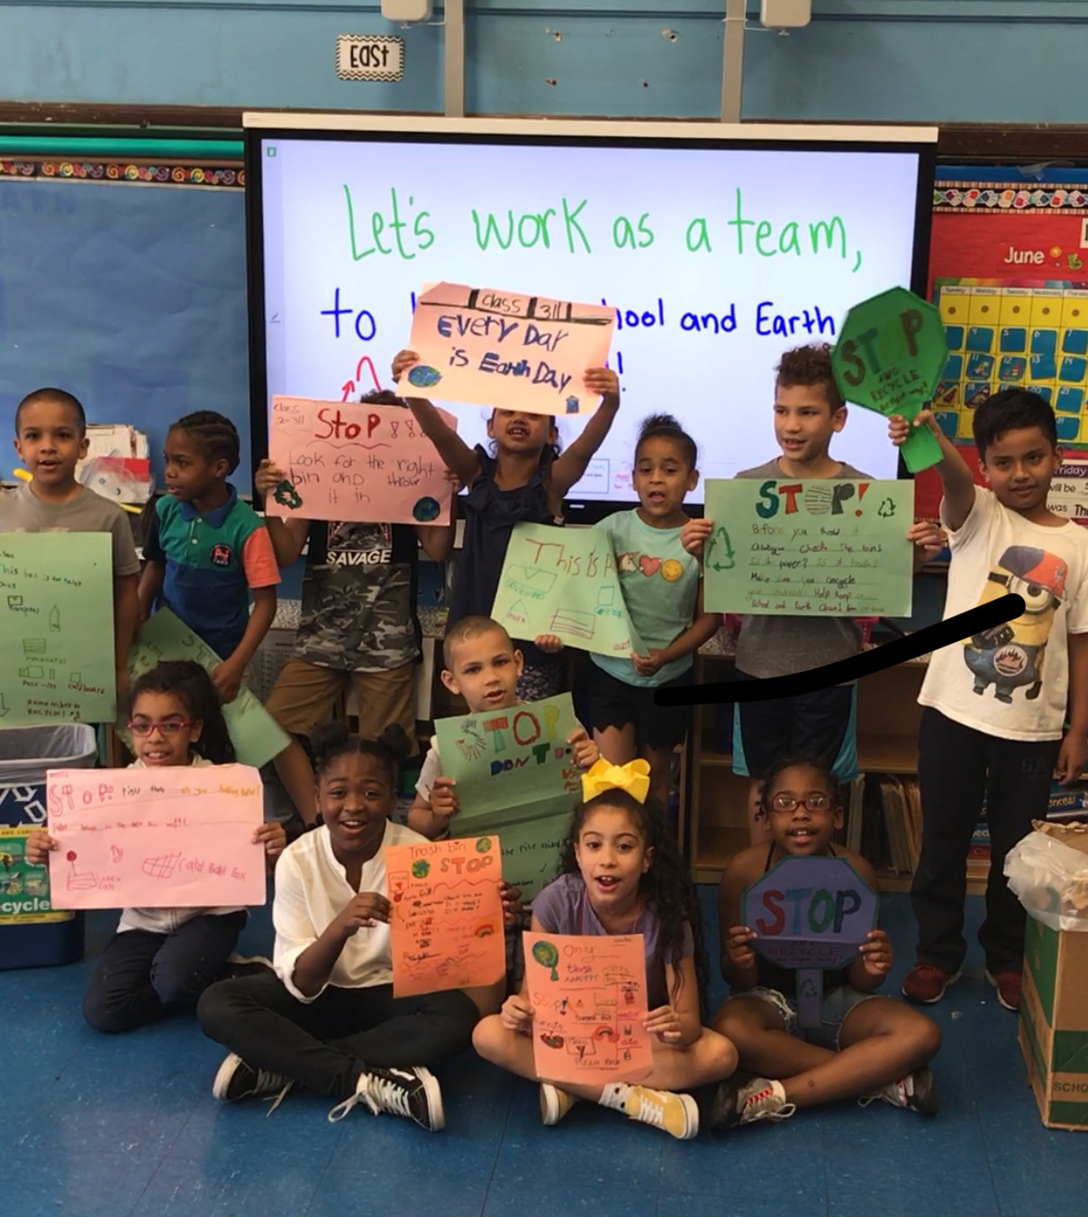
Take A Stand: Project Based Inquiry
Line of Inquiry
Infuse literacy instruction and practice into Social Studies
Focus on developing understanding of content through oral language
Protocols implemented/opportunity for talk
Final Project, Take A Stand, was a culmination of the work done together throughout the year
Integrating all literacy skills with activism
Finding their Voice → Big Idea: “We can use our voices for positive change.”
Notes:
Line of Inquiry: Infuse literacy instruction and practice into Social Studies
Planning Social Studies content with literacy focus and goals (vocabulary, comprehension, oral language skills)
Focus on developing understanding through oral language
Opportunities for student talk and protocols to put in place
Final Project, Take A Stand, was a culmination of the work done together throughout the year
Looking at final Social Studies unit, revised plans and content to make it relatable and purposeful
Utilizing group protocols and talk moves to contribute to PSA
Finding their Voice
Idea came from students, of high interest and concern
Doing something with what they learned, creating an end goal
Big Idea: “We can use our voices for positive change.”

Slide 3
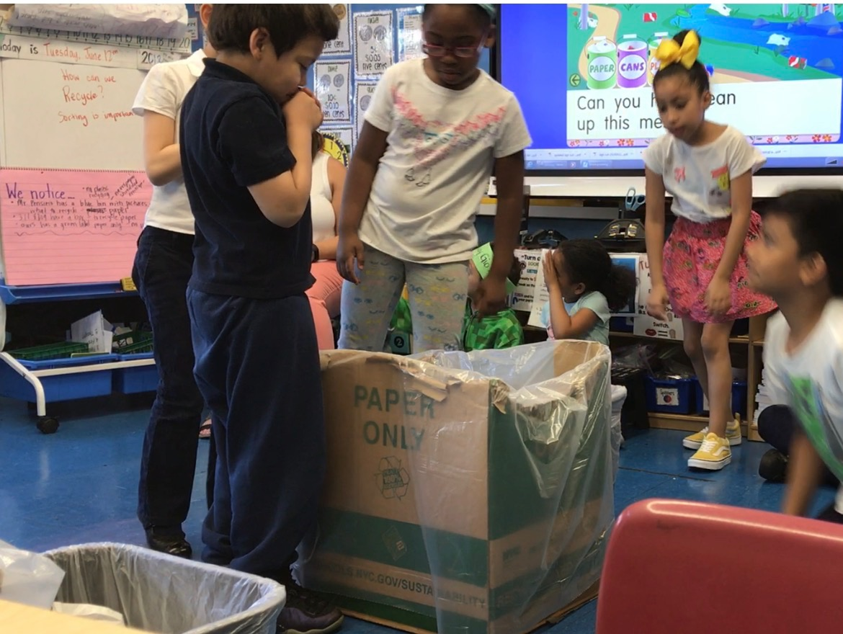
Take A Stand - Inquiry Unit Plan
Big Idea or Concept: Major Content:
3-5 Mentor Texts: | Charts:
Content Vocabulary: | Academic Vocabulary:
Whoe Class/Small Group/Station Activities: How to introduce? Identify problem. Rational Student action: What can we do about it? (Lessons) → Gather information/data/evidence: → Record → Analyze the data → Come up with a plan
How will students apply their knowledge (project/assignment etc.):
Big Idea:
What does it mean to be an informed and contributing citizen?
We can use our voices for positive change.
Major Content
Recycling: What does it mean? How can it help?
Mentor Texts
Charts

Slide 4
Take A Stand - Inquiry Unit Plan
Big Idea or Concept: Major Content:
3-5 Mentor Texts: | Charts:
Content Vocabulary: | Academic Vocabulary:
Whoe Class/Small Group/Station Activities: How to introduce? Identify problem. Rational Student action: What can we do about it? (Lessons) → Gather information/data/evidence: → Record → Analyze the data → Come up with a plan
How will students apply their knowledge (project/assignment etc.):
Vocabulary
Content: Responsible, Recycle, Conserve,
Academic: Evidence, Research, Data, Survey
Whole Class/Small Group/Station Activities
Rational: Why is it important to our school?
Student Action: What can we do about it?
Culminating Project: How will they apply their knowledge
Assembly, posters, PSA, recycled materials crafts, etc.

Slide 5
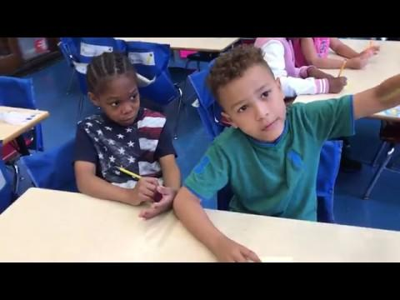
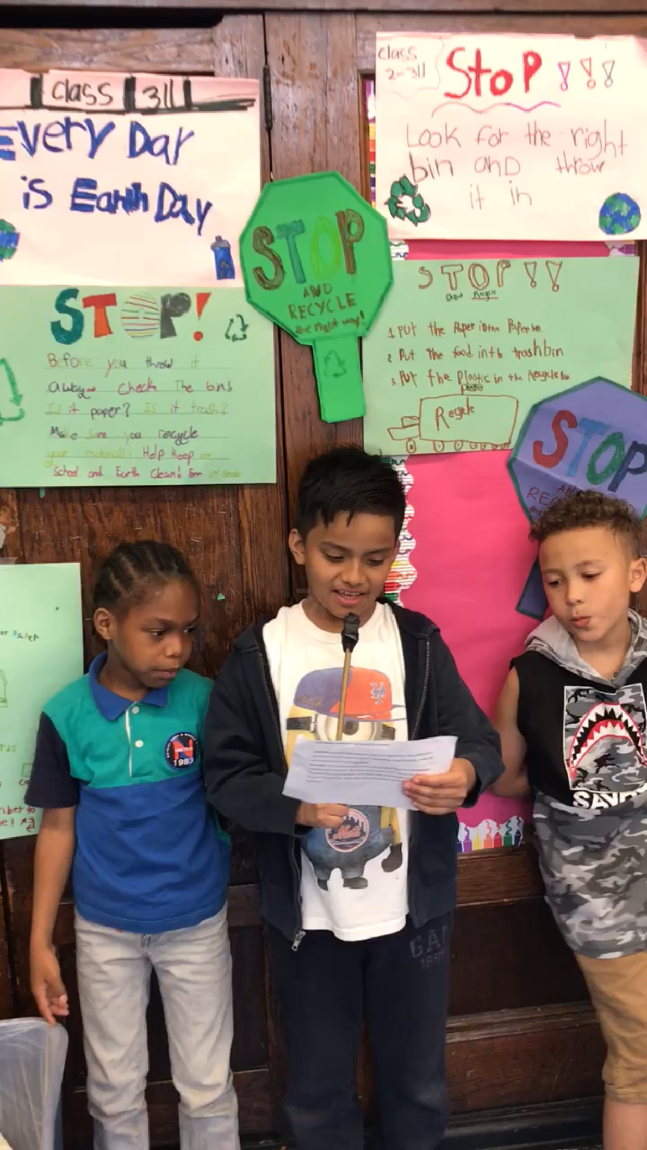
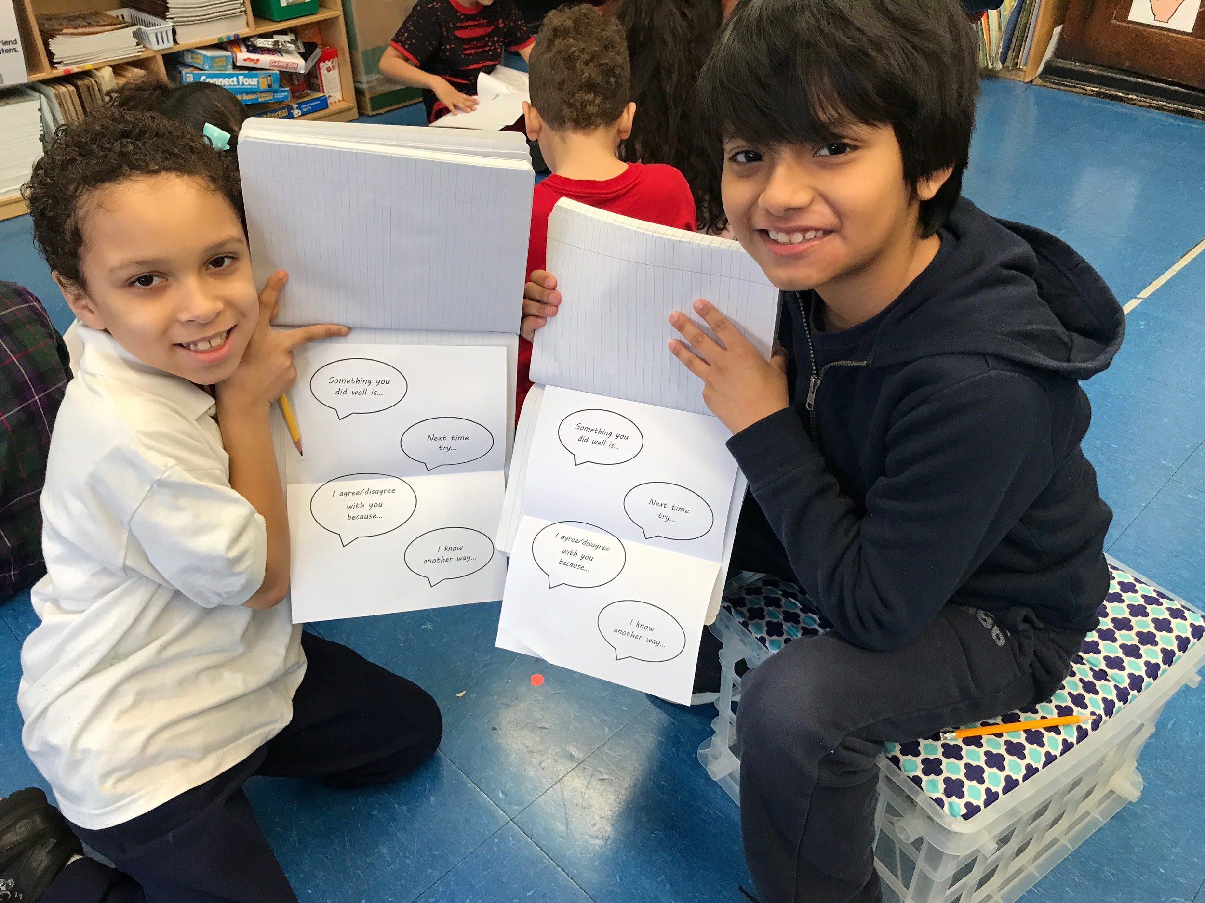
Reflection
Student growth → Strengthening my voice as a teacher
Development of oral language and progression to writing skills
Student engagement creating stronger impact
Purposeful for all
Taking curriculum and making it meaningful
Sparks curiosity and joy for learning
Helps deepen learning and connections within the classroom environment

Slide 6
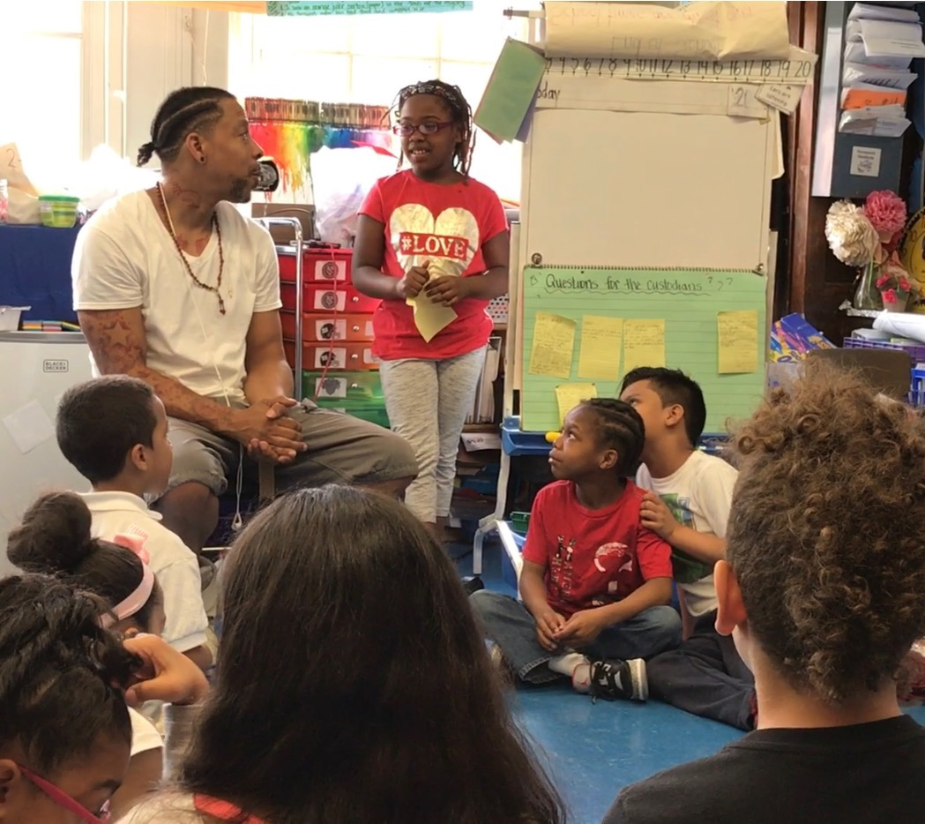
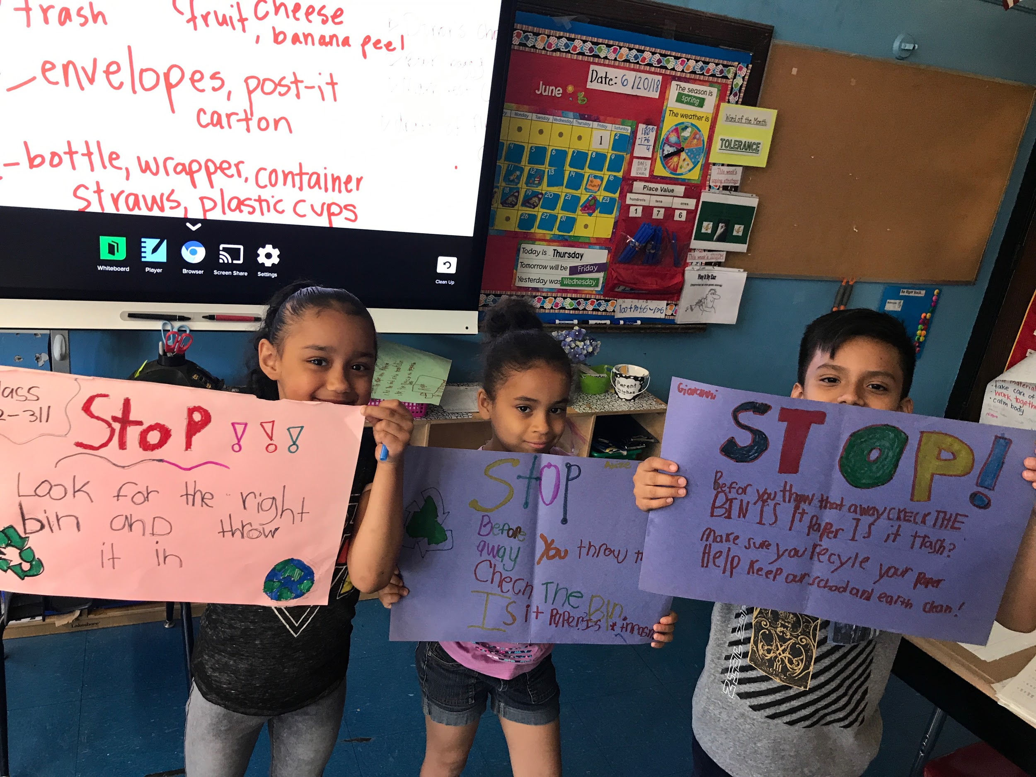
Takeaways
Teachers have a voice when they have time to focus on areas of interest
When teachers have a voice there is space to support students’ voices
Carly Metzger, Second Grade Teacher, PS 72 District 4 NYC
Rosanne L. Kurstedt, Ph.D. rk1410@hunter.cuny.edu

